Slide 1
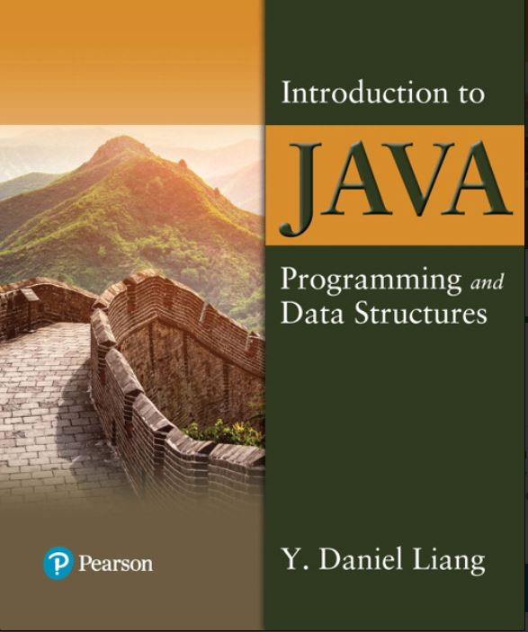

Introduction to Java Programming and Data Structures
Twelfth Edition
Chapter 2
Elementary Programming
Copyright © 2020 Pearson Education, Inc. All Rights Reserved
Notes:
If this PowerPoint presentation contains mathematical equations, you may need to check that your computer has the following installed:
1) MathType Plugin
2) Math Player (free versions available)
3) NVDA Reader (free versions available)
Slides in this presentation contain hyperlinks. JAWS users should be able to get a list of links by using INSERT+F7

Slide 2
Motivations
In the preceding chapter, you learned how to create, compile, and run a Java program. Starting from this chapter, you will learn how to solve practical problems programmatically. Through these problems, you will learn Java primitive data types and related subjects, such as variables, constants, data types, operators, expressions, and input and output.

Slide 3
Objectives (1 of 2)
2.1 To write Java programs to perform simple computations (§2.2).
2.2 To obtain input from the console using the Scanner class (§2.3).
2.3 To use identifiers to name variables, constants, methods, and classes (§2.4).
2.4 To use variables to store data (§§2.5–2.6).
2.5 To program with assignment statements and assignment expressions (§2.6).
2.6 To use constants to store permanent data (§2.7).
2.7 To name classes, methods, variables, and constants by following their naming conventions (§2.8).
2.8 To explore Java numeric primitive data types: byte, short, int, long, float, and double (§2.9).
2.9 To read a byte, short, int, long, float, or double value from the keyboard (§2.9.1).
2.10 To perform operations using operators +,
(§2.9.2).
2.11 To perform exponent operations using Math.pow(a, b) (§2.9.3).
2.12 To write integer literals, floating-point literals, and literals in scientific notation (§2.10)

Slide 4
Objectives (2 of 2)
2.14 To write and evaluate numeric expressions (§2.12).
2.16 To use augmented assignment operators (§2.14).
2.17 To distinguish between postincrement and preincrement and between postdecrement and predecrement (§2.15).
2.18 To cast the value of one type to another type (§2.16).

Slide 5
Introducing Programming With an Example
Listing 2.1 Computing the Area of a Circle
This program computes the area of the circle.
ComputeArea
Note: Clicking the green button displays the source code with interactive animation. You can also run the code in a browser. Internet connection is needed for this button.
Notes:
ComputeArea: https://liveexample.pearsoncmg.com/html/ComputeArea.html

Slide 6
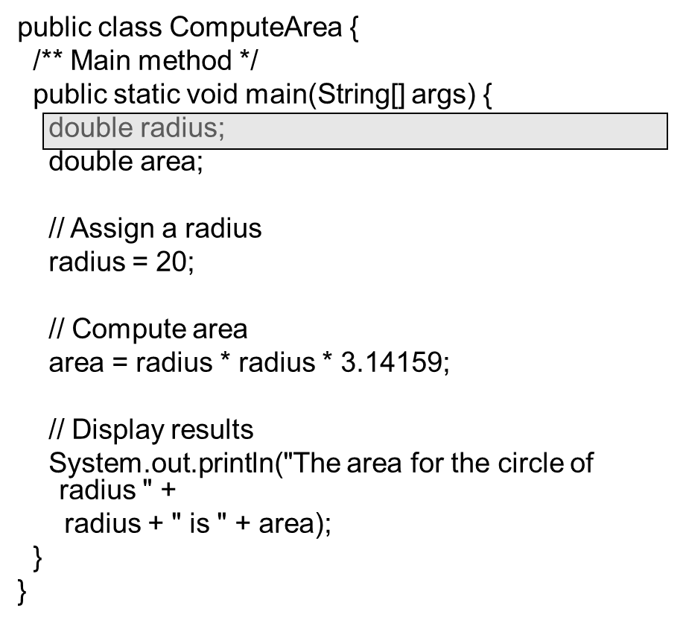
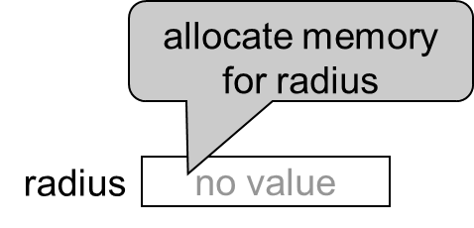
Trace a Program Execution (1 of 5)

Slide 7
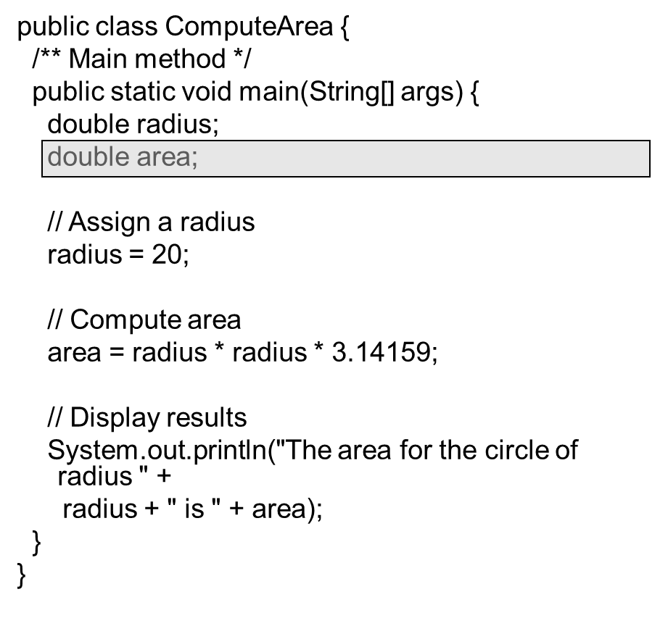
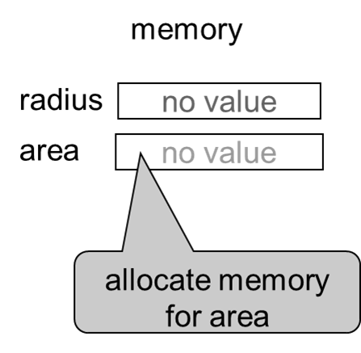
Trace a Program Execution (2 of 5)

Slide 8
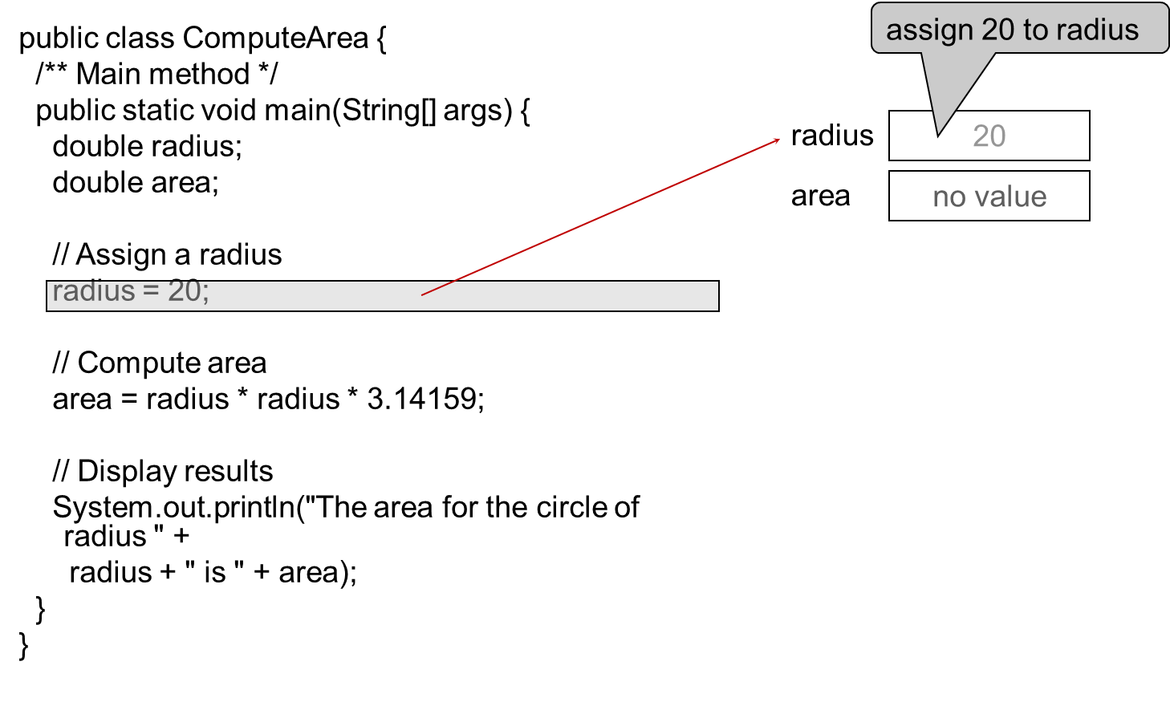
Trace a Program Execution (3 of 5)

Slide 9
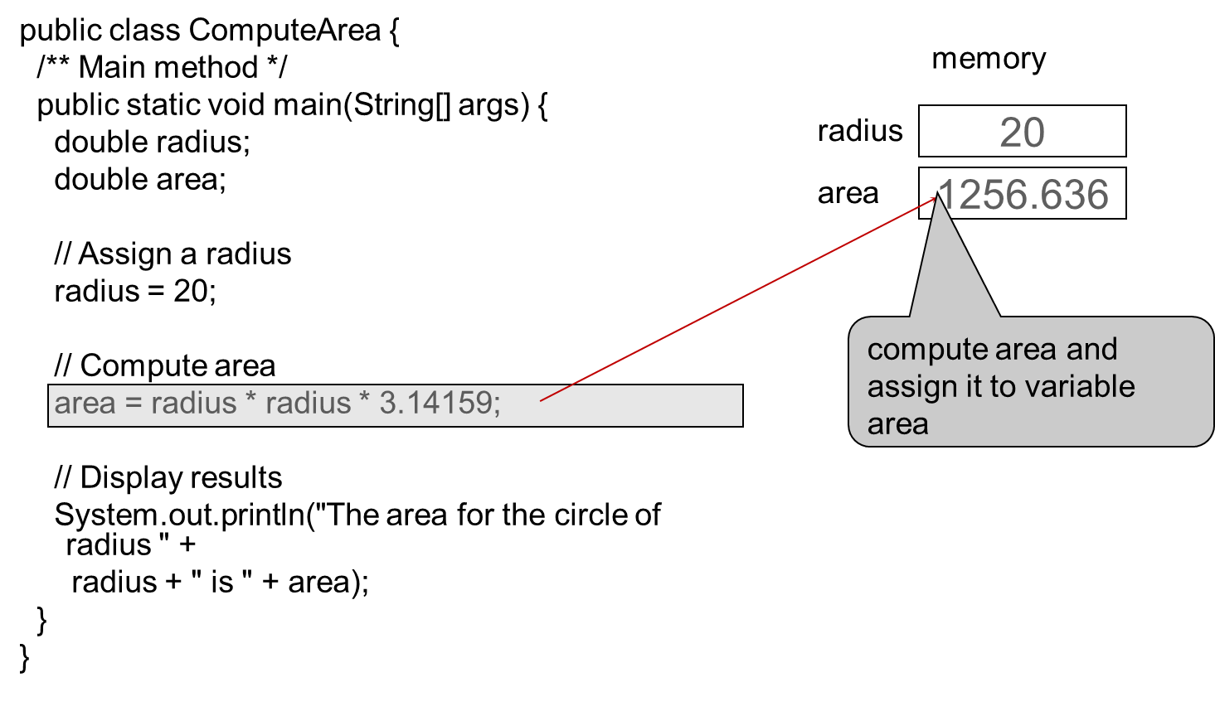
Trace a Program Execution (4 of 5)
Notes:
A text box next to radius reads, 20.
A text box next to the area reads, 1256.636.
An arrow points to the text box next to the area. The arrow reads, compute area and assign it to the variable area.
A line connects the text box next to the area and the text box that reads, radius times radius times 3.14159.

Slide 10
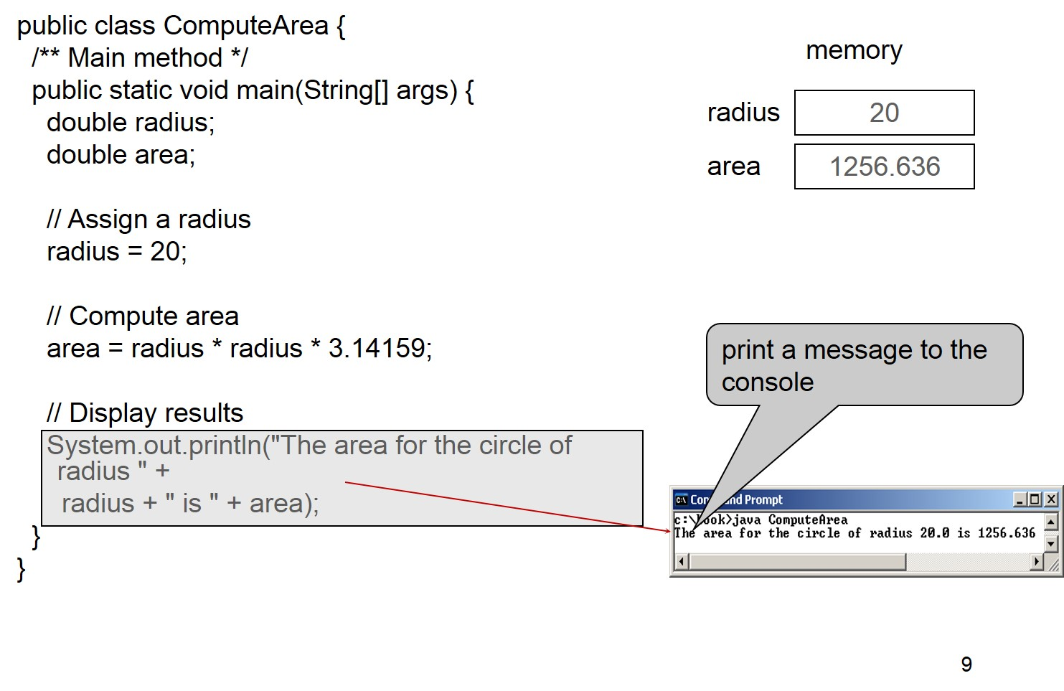
Trace a Program Execution (5 of 5)
Notes:
left brace
forward slash asterisk symbol Main method asterisk symbol forward slash
public static void main left parenthesis String left bracket right bracket args right parenthesis left brace
double radius semi colon
double area semi colon
Forward slash forward slash Assign a radius
radius = 20 semi colon
forward slash forward slash Compute area
area = radius times radius times 3.14159 semi colon
Forward slash forward slash Display results
System.out.println left parenthesis start double quotation marks The area for the circle of radius end double quotation marks +
radius + start double quotation marks is end quotation marks + area left parenthesis semi colon
right brace
right brace
Right this code block are two text boxes for memory, with value for radius as 20 and for area as 1256.636. Below these text boxes is a text file containing code block with row labeled, print a message to the console."

Slide 11
Reading Input From the Console
Create a Scanner object
Scanner input = new Scanner(System.in);
Use the method nextDouble() to obtain to a double value. For example,
System.out.print("Enter a double value: ");
Scanner input = new Scanner(System.in);
double d = input.nextDouble();
ComputeAreaWithConsoleInput
ComputeAverage
Notes:
ComputeAreaWithConsoleInput: https://liveexample.pearsoncmg.com/html/ComputeAreaWithConsoleInput.html
ComputeAverage: https://liveexample.pearsoncmg.com/html/ComputeAverage.html

Slide 12
Implicit Import and Explicit Import
java.util.* ; // Implicit import
java.util.Scanner; // Explicit Import
No performance difference

Slide 13
Identifiers
An identifier is a sequence of characters that consist of letters, digits, underscores (_), and dollar signs ($).
An identifier must start with a letter, an underscore (_), or a dollar sign ($). It cannot start with a digit.
An identifier cannot be a reserved word. (See Appendix A, “Java Keywords,” for a list of reserved words).
An identifier cannot be true, false, or null.
An identifier can be of any length.

Slide 14
Variables
// Compute the first area
radius = 1.0;
area = radius * radius * 3.14159;
System.out.println("The area is “ + area + " for radius "+radius);
// Compute the second area
radius = 2.0;
area = radius * radius * 3.14159;
System.out.println("The area is “ + area + " for radius "+radius);

Slide 15
Declaring Variables
int x; // Declare x to be an
// integer variable;
double radius; // Declare radius to
// be a double variable;
char a; // Declare a to be a
// character variable;

Slide 16
Assignment Statements
x = 1; // Assign 1 to x;
radius = 1.0; // Assign 1.0 to radius;
a = 'A'; // Assign 'A' to a;

Slide 17
Declaring and Initializing in One Step
int x = 1;
double d = 1.4;

Slide 18
Named Constants
final datatype CONSTANTNAME = VALUE;
final double PI = 3.14159;
final int SIZE = 3;

Slide 19
Naming Conventions (1 of 2)
Choose meaningful and descriptive names.
Variables and method names:
Use lowercase. If the name consists of several words, concatenate all in one, use lowercase for the first word, and capitalize the first letter of each subsequent word in the name. For example, the variables radius and area, and the method computeArea.

Slide 20
Naming Conventions (2 of 2)
Class names:
Capitalize the first letter of each word in the name. For example, the class name ComputeArea.
Constants:
Capitalize all letters in constants, and use underscores to connect words. For example, the constant PI and MAX_VALUE

Slide 21
Numerical Data Types
Name | Range | Storage Size
byte | negative 2 to the power 7 to 2 to the power 7 minus 1 left parenthesis negative 128 to 127 right parenthesis. | 8-bit signed
short | negative 2 to the power 15 to 2 to the power 15 minus 1 left parenthesis (negative 32768 to 32767 right parenthesis. | 16-bit signed
int | negative 2 to the power 31 to 2 to the power 31 minus 1 left parenthesis negative 2147483648 to 2147483647 right parenthesis. | 32-bit signed
long | negative 2 to the power 63 to 2 to the power 63 minus 1 left parenthesis that is, negative 9223372036854775808 to 9223372036854775807 right parenthesis. | 64-bit signed
float | negative range, negative -3.4028235 E + 38 to negative 1.4 E minus 45, positive range, 1.4 E minus 45 to 3.4028235 E + 38. | 32-bit I E E E 754
double | negative range, negative 1.7976931348623157 E + 308 to negative 4.9 E minus 324, positive range, 4.9 E minus 324 to 1.7976931348623157 E + 308. | 64-bit I E E E 754

Slide 22
Reading Numbers From the Keyboard
Scanner input = new Scanner(System.in);
int value = input.nextInt();
Method | Description
nextByte() | reads an integer of the byte type.
nextShort() | reads an integer of the short type.
nextInt() | reads an integer of the int type.
nextLong() | reads an integer of the long type.
nextFloat() | reads a number of the float type.
nextDouble() | reads a number of the double type.

Slide 23
Numeric Operators
Name | Meaning | Example | Result
+ | Addition | 34 + 1 | 35
The symbol of minus | Subtraction | 34.0 minus 0.1 | 33.9
* | Multiplication | 300 times 30 | 9000
division slash | Division | 1.0 divided by 2.0. | 0.5
symbol of modulo remainder | Remainder | 20 modulo remainder 3 | 2

Slide 24
Integer Division
+,
*, /, and %
yields an integer 2.
yields a double value 2.5
5 % 2 yields 1 (the remainder of the division)

Slide 25
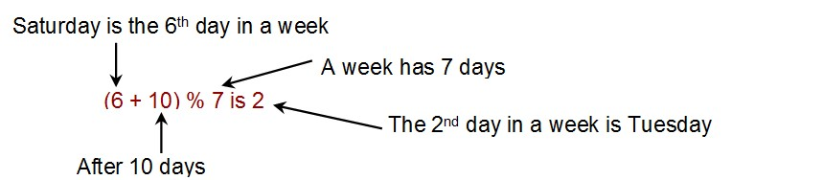
Remainder Operator
Remainder is very useful in programming. For example, an even number % 2 is always 0 and an odd number % 2 is always 1. So you can use this property to determine whether a number is even or odd. Suppose today is Saturday and you and your friends are going to meet in 10 days. What day is in 10 days? You can find that day is Tuesday using the following expression:
Notes:
In this equation, an arrow points at 6. The arrow is labeled as Saturday is the 6th day in a week. 10 in the equation is labeled as After 10 days. 7 in the equation is labeled, A week has 7 days. 2 in the equation is labeled, The 2nd day in a week is Tuesday.

Slide 26
Note
Calculations involving floating-point numbers are approximated because these numbers are not stored with complete accuracy. For example,
System.out.println(1.0 - 0.1 - 0.1 - 0.1 - 0.1 - 0.1);
displays 0.5000000000000001, not 0.5, and
System.out.println(1.0 - 0.9);
displays 0.09999999999999998, not 0.1. Integers are stored precisely. Therefore, calculations with integers yield a precise integer result.

Slide 27
Exponent Operations
System.out.println(Math.pow(2, 3));
// Displays 8.0
System.out.println(Math.pow(4, 0.5));
// Displays 2.0
System.out.println(Math.pow(2.5, 2));
// Displays 6.25
System.out.println(Math.pow(2.5, -2));
// Displays 0.16

Slide 28
Number Literals
A literal is a constant value that appears directly in the program. For example, 34, 1,000,000, and 5.0 are literals in the following statements:
int i = 34;
long x = 1000000;
double d = 5.0;

Slide 29
Integer Literals
An integer literal can be assigned to an integer variable as long as it can fit into the variable. A compilation error would occur if the literal were too large for the variable to hold. For example, the statement byte b = 1000 would cause a compilation error, because 1000 cannot be stored in a variable of the byte type.
An integer literal is assumed to be of the int type, whose
value is between
To denote an integer literal of the long type, append it with the letter L or l. L is preferred because l (lowercase L) can easily be confused with 1 (the digit one).

Slide 30
Floating-Point Literals
Floating-point literals are written with a decimal point. By default, a floating-point literal is treated as a double type value. For example, 5.0 is considered a double value, not a float value. You can make a number a float by appending the letter f or F, and make a number a double by appending the letter d or D. For example, you can use 100.2f or 100.2F for a float number, and 100.2d or 100.2D for a double number.

Slide 31
double versus float
The double type values are more accurate than the float type values. For example,
System.out.println("1.0 / 3.0 is " + 1.0 / 3.0);
displays
System.out.println("1.0F / 3.0F is " + 1.0F / 3.0F);
displays

Slide 32
Scientific Notation
Floating-point literals can also be specified in scientific notation, for example, 1.23456e+2, same as 1.23456e2, is
equivalent to 123.456, and
is equivalent to
0.0123456. E (or e) represents an exponent and it can be either in lowercase or uppercase.

Slide 33
Arithmetic Expressions
is translated to

Slide 34
How to Evaluate an Expression
Though Java has its own way to evaluate an expression behind the scene, the result of a Java expression and its corresponding arithmetic expression are the same. Therefore, you can safely apply the arithmetic rule for evaluating a Java expression.
Notes:
3 + 4 times 4 + 5 times 7 minus 1 (multiplication sign between 4 and 4 is labeled, (2) multiplication.
3 + 16 + 5 times 7 minus 1 (multiplication sign between 5 and 7 is labeled, (3) multiplication.
3 + 16 + 35 minus 1 (+ sign between 3 and 16 is labeled, (4) addition.
19 + 35 minus 1 (+ sign between 19 and 35 is labeled, (5) addition.
54 minus 1 (minus sign between 54 and 1 is labeled, (6) subtraction.
53.

Slide 35
Problem: Converting Temperatures
Write a program that converts a Fahrenheit degree to Celsius using the formula:
Note: you have to write
FahrenheitToCelsius
Notes:
FahrenheitToCelsius: https://liveexample.pearsoncmg.com/html/FahrenheitToCelsius.html

Slide 36
Augmented Assignment Operators
Operator | Name | Example | Equivalent
+= | Addition assignment | i += 8 | i = i + 8
negative = | Subtraction assignment | i minus = 8 | I = I minus 8
*= | Multiplication assignment | i *= 8 | i = i * 8
forward slash = | Division assignment | I forward slash = 8 | I = I over 8
%= | Remainder assignment | i %= 8 | i = i % 8

Slide 37
Increment and Decrement Operators (1 of 3)
Operator | Name | Description | Example (assume i = 1)
++var | preincrement | Increment var by 1, and use the new var value in the statement | int j = ++i; // j is 2, i is 2
var++ | postincrement | Increment var by 1, but use the original var value in the statement | int j = i++; // j is 1, i is 2
dash dash variable; | predecrement | Decrement var by 1, and use the new var value in the statement | int j = --i; // j is 0, i is 0
variable dash dash; | postdecrement | Decrement var by 1, and use the original var value in the statement | int j = i--; // j is 1, i is 0

Slide 38
Increment and Decrement Operators (2 of 3)

Slide 39
Increment and Decrement Operators (3 of 3)
Using increment and decrement operators makes expressions short, but it also makes them complex and difficult to read. Avoid using these operators in expressions that modify multiple variables, or the same variable for multiple times such as this: int k = ++i + i.

Slide 40
Assignment Expressions and Assignment Statements
Prior to Java 2, all the expressions can be used as statements. Since Java 2, only the following types of expressions can be statements:
variable op= expression; // Where op is +,
++variable;
variable++;

Slide 41
Numeric Type Conversion
Consider the following statements:
byte i = 100;
long k = i * 3 + 4;
double d = i * 3.1 + k / 2;

Slide 42
Conversion Rules
When performing a binary operation involving two operands of different types, Java automatically converts the operand based on the following rules:
If one of the operands is double, the other is converted into double.
Otherwise, if one of the operands is float, the other is converted into float.
Otherwise, if one of the operands is long, the other is converted into long.
Otherwise, both operands are converted into int.

Slide 43
Type Casting
Implicit casting
double d = 3; (type widening)
Explicit casting
int i = (int)3.0; (type narrowing)
int i = (int)3.9; (Fraction part is truncated)
What is wrong?

Slide 44
Casting in an Augmented Expression
In Java, an augmented expression of the form x1 op= x2 is implemented as x1 = (T)(x1 op x2), where T is the type for x1. Therefore, the following code is correct.
int sum = 0;
sum += 4.5; // sum becomes 4 after this statement
sum += 4.5 is equivalent to sum = (int)(sum + 4.5).

